Slide 1
Promotion and Tenure Committee Workshop
SEPTEMBER 29, 2022

Slide 2
AGENDA
Introductions
P&T perceptions and outcomes
P&T process and policies
COVID Adaptions
Department heads’ perspectives
Dean’s perspective
University P&T Committee’s perspective
Questions and discussion

Slide 3
P&T Perceptions AND Outcomes
Ron fricker, vice provost for faculty affairs

Slide 4
CLARITY OF TENURE PROCESS
FROM 2020 COACHE FACULTY JOB SATISFACTION SURVEY
Survey Question: Please rate the clarity of the following aspects of earning tenure in your department: The tenure process

Slide 5
PROMOTION AND TENURE SUCCESS 2012-2022

Slide 6
P&T PROCESSES AND PRACTICES
Ron fricker, vice provost for faculty affairs

Slide 7
P&T Governed by Faculty Handbook
Section 3.4 in particular:
See https://faculty.vt.edu/faculty-handbook.html

Slide 8
Important Info on Provost’s Website
Dossier template and preparation guidelines
University-level deadlines for promotion and tenure review
P&T Workshop dates
Historical summary of P&T outcomes
See https://faculty.vt.edu/promotion-tenure.html

Slide 9
PROMOTION AND TENURE PROCESS
Department Level
College Level
University Level
Dossier
P&T Comm
Head
P&T Comm
Dean
P&T Comm
Provost
External Letters
BOV
President

Slide 10
PROMOTION AND TENURE SCHEDULE
April/May | Departments evaluate candidates for promotion
June | External reviewers selected and invited
July/August | Dossiers completed and sent to external reviewers
October | Department committee and head review
November | Dossiers sent to college
Dec/Jan | College committee and dean review
Jan/Feb | Dossiers submitted to Provost office from colleges Materials distributed to university committee
March/April | University committee and provost review
April | Provost makes recommendations to President
June | President submits recommendations to BOV BOV approval – faculty notified
Sept/Oct | Reception for promoted faculty

Slide 11
PROMOTION AND TENURE DOSSIER OUTLINE
I. Executive Summary
II. Recommendation Statements
III. Candidate’s Statement
IV. Teaching and Advising Effectiveness
V. Research and Creative Activities
VI. International & Professional Service and Other Outreach & Extension Activities
VII. University Service
VIII. Work Under Review or In Progress
IX. Other Pertinent Activities
See https://faculty.vt.edu/promotion-tenure.html

Slide 12
P&T POLICIES AND PRACTICES
POLICIES
2nd and 4th year progress reviews
Tenure clock extension(s)
Modified duties
Non-mandatory promotion to associate with tenure
Progress toward promotion to professor
PRACTICES
Mentoring
P&T Workshops
P&T Committee and Heads
Promotion to Professor
College-based workshops
Written expectations and standards

Slide 13
COVID-19 IMPACT CONSIDERATIONS
Faculty COVID statements
Inclusion of cancelled/postponed and/or virtual presentations
SPOT scores for calendar year 2020 optional
Tenure Clock Extensions
Work assignment adjustments
Modified duties
External letter reuse
See https://faculty.vt.edu/promotion-tenure/adaptations-promotion-tenure-process.html

Slide 14
P&T PERSPECTIVES
Department Heads
Dean
University P&T Committee

Slide 15
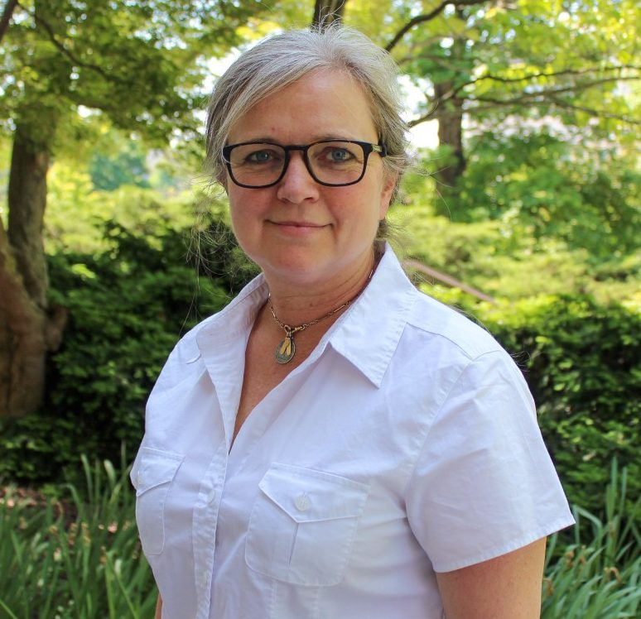
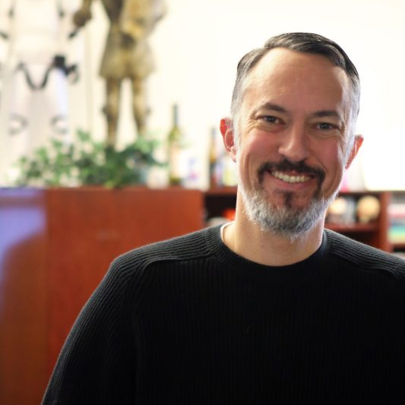
DEPARTMENT HEADS’ PERSPECTIVES
Ann-Marie Knoblauch
School of Visual Arts
Matthew Gabriele
Religion & Culture

Slide 16
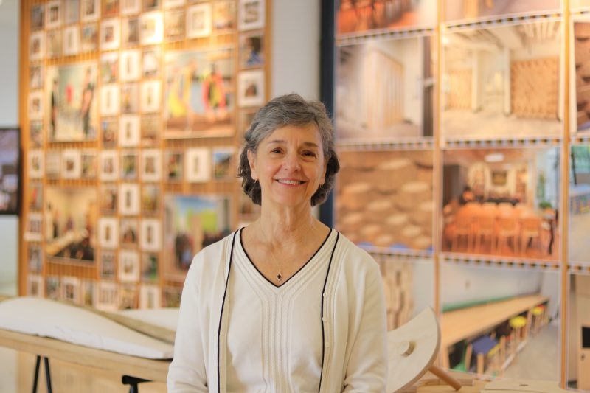
DEAN’S PERSPECTIVE
Rosemary Blieszner
Architecture, Arts, and Design

Slide 17
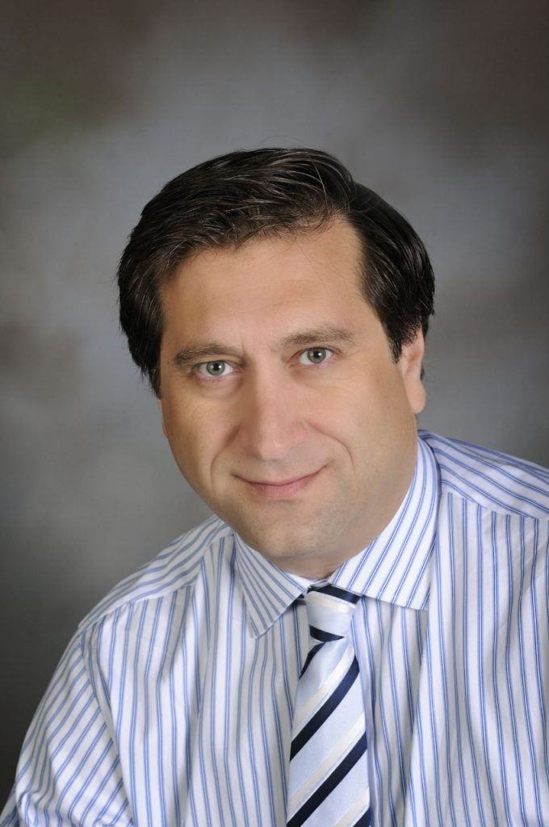
UNIVERSITY P&T COMMITTEE PERSPECTIVE
Reza Barkhi
Accounting & Information Systems

Slide 18
Questions and discussion
Visit the Promotion and Tenure website for more information:
https://faculty.vt.edu/promotion-tenure.html

Slide 19
OTHER RESOURCES

Slide 20
COLLEGE P&T GUIDELINES
College of Agriculture and Life Sciences
College of Architecture, Arts, and Design
College of Engineering
College of Liberal Arts and Human Sciences
College of Natural Resources and the Environment
College of Science
Pamplin College of Business
Virginia-Maryland College of Veterinary Medicine
Virginia Tech Carilion School of Medicine

